Slide 1


Credit Card Fraud Detection via Machine Learning Techniques
Presenter: Vahdet Sufyan Taskin
Supervisor: Dr. David Leonard

Slide 2
Research Objectives and Approach
The primary aim of the study is to implement Random Forest and Decision Trees algorithms for fraud detection.
The aims of scrutinizing the effectiveness of conventional algorithms of Data Mining in coping with administration of data requires of credit card fraud are assessed via using these methods.
In this project, 30% of the dataset allocated for test, and 70% of the scaled data allocated for train of the model. The main idea of using 30% of the dataset for the test of the model is to compare different pre-processing techniques, SMOTE and under-sampling on the imbalanced data.

Slide 3
Credit Card Fraud Credit card fraud is an involved word for fraud committed utilizing a payment card, such as a debit card or credit card. The aim can be to get goods or to make payment to another account that is commanded by a criminal. Credit Card Fraud Detection Detection of credit card fraud is the procedure of identifying purchase attempts which are fraudulent and rejecting them rather than processing the operation.

Slide 4
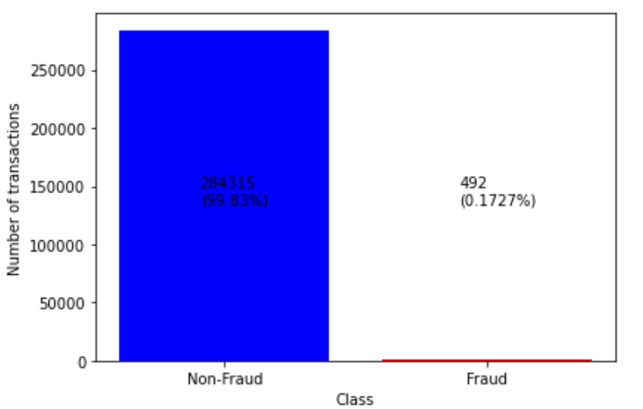
Exploratory Data Analysis
The credit card fraud dataset contains 284,807 transactions, and 492 of them are fraud. The dataset contains 31 parameters. It is highly imbalanced. It is obtained from Kaggle.
Attributes | Variable Type | Variable Description
Time | int | Time between each transaction
V1 | Num | Attribute variable converted with PCA
V2 | Num | Attribute variable converted with PCA
. | . | -------
V28 | Num | Attribute variable converted with PCA
Amount | Num | Total transactions
Class | İnt | Response feature (0= non-Fraudulent and 1 = Fraudulent)

Slide 5
Decision Trees (DT)
What Are the Advantages of Decision Trees?
Simple to understand and to interpret. Trees can be visualized.
Requires little data preparation.
Able to handle both numerical and categorical data.
Able to handle multi-output problems.
Uses a white box model. If a given situation is observable in a model, the explanation for the condition is easily explained by boolean logic.

Slide 6
Random Forest (RF)
What Are the Advantages of Random Forest?
It can perform both regression and classification tasks.
A random forest produces good predictions that can be understood easily.
It can handle large datasets efficiently.
The random forest algorithm provides a higher level of accuracy in predicting outcomes over the decision tree algorithm.

Slide 7
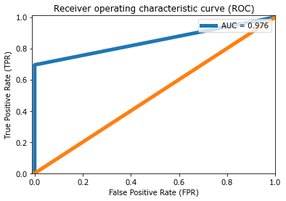
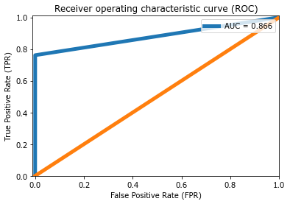
Original DataSET (No Smote)
Model | Accuracy | Recall | F1 Score | Precision
RF_OrijnalData | 0.999448 | 0.694030 | 0.798283 | 0.939394
DT_OrjinalData | 0.999483 | 0.761194 | 0.822581 | 0.894737
Random Forest
Decision Tree

Slide 8
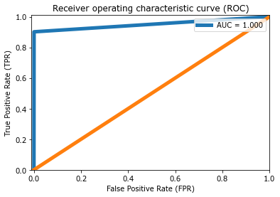

Threshold Optimization Approach
Random Forest
Decision Tree
Model | Accuracy | Recall | F1 Score | Precision
RF_Threshold | 0.998183 | 0.901515 | 0.929688 | 0.959677
DT_Threshold | 0.998183 | 0.909091 | 0.930233 | 0.952381

Slide 9
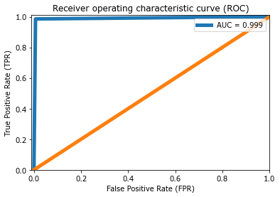

SMOTE Optimization Approach
Model | Accuracy | Recall | F1- Score | Precision
RF_Smote | 0.989503 | 0.985663 | 0.989463 | 0.993292
DT_Smote | 0.988479 | 0.985151 | 0.988441 | 0.991753
Random Forest
Decision Tree

Slide 10
General Evaluation
 |  | Accuracy | Recall | F1 Score | Precision
1 | RF_OriginalData | 0.999448 | 0.694030 | 0.798283 | 0.939394
2 | DT_OriginalData | 0.999483 | 0.761194 | 0.822581 | 0.894737
3 | RF_Threshold | 0.998183 | 0.901515 | 0.929688 | 0.959677
4 | DT_Threshold | 0.998183 | 0.909091 | 0.930233 | 0.952381
5 | RF_Smote | 0.989503 | 0.985663 | 0.989463 | 0.993292
6 | DT_Smote | 0.988479 | 0.985151 | 0.988441 | 0.991753

Slide 11

Conclusions
Considering the results obtained, two algorithms bring out excellent outcomes. Results of both algorithms are so close to each other. Despite the size of the data set used, the availability and reliability of the obtained accuracy rates are at a suitable level for the detection of credit card fraud.

Slide 12
Thank you…

